Slide 1


WATERFALL MODEL
Software Development Model

Slide 2
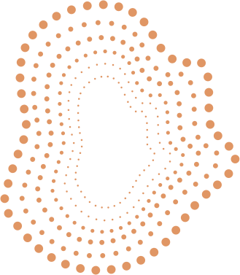
Introduction
  Waterfall Model is a traditional software development methodology
  It follows a linear and sequential approach
  Each phase must be completed before moving to the next
  Easy to understand and manage

Slide 3

What is the Waterfall Model?
  A linear sequential software development life cycle (SDLC) model
  Progress flows downward like a waterfall
  No overlapping between phases
  Best suited for small and well-defined projects
  It is rigid and does not easily accommodate changes.

Slide 4

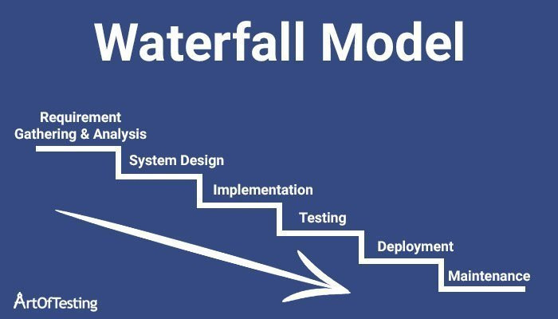
Phases of Waterfall Model

Slide 5
Requirement Analysis
  Understanding user needs and system requirement
  Requirements are documented clearly
  Forms the foundation for all future phases
  Errors here affect the entire project
What happens in this phase?
We collect and document what the user wants.

Slide 6
Example
Librarian wants:
  Add / remove books
  Issue and return books
  Search books by name/author
  Maintain student records
These requirements are written clearly in a document

Slide 7
System Design
  Defines system architecture and design specification
  Hardware and software requirements are decided
  Helps developers understand how the system will work
What happens here?
We decide how the system will work.

Slide 8
Example
Decide:
  Frontend: HTML, CSS
  Backend: Java / Python
  Database: MySQL
Design:
  Login page
  Book table
  Student table

Slide 9
Implementation
  Actual coding of the software takes place
  Each module is developed individually
  Follows the design specifications
  Programming languages and tools are used
What happens here?
Actual coding starts.

Slide 10
Example
Write code to:
  Add books
  Issue books
  Return books
Each module is coded separately

Slide 11
Testing
  Software is tested for errors and bugs
  Ensures the system meets requirements
  Includes unit testing, integration testing, and system testing
What happens here?
We check whether the system works correctly.

Slide 12
Example
Test:
  Can the same book be issued twice?
  What happens if a wrong student ID is entered?
  Are search results correct?

Slide 13
Deployment
  Software is delivered to the customer
  Installed and configured in real environment
  End users start using the system
What happens here?
The software is delivered to the user.

Slide 14
Example
  Library system is installed in the college computer
  Librarian starts using it

Slide 15
Maintenance
  Fixes bugs found after deployment
  Improves performance and features
  Ongoing process throughout software life
What happens here?
Fix issues and add small improvements.

Slide 16
Example
  Fix bugs if found
Add new feature like:
  Fine calculation
  Online book reservation

Slide 17
Advantages of Waterfall Model
  Simple and easy to understand
  Well-structured and disciplined approach
  Clear documentation at every stage
  Easy to manage due to fixed phases

Slide 18
Disadvantages of Waterfall Model
  Not flexible to changes
  Testing is done late in the process
  High risk for long and complex projects
  Customer feedback comes very late

Slide 19
When to Use Waterfall Model
  Requirements are very clear and fixed
  Small-scale projects
  Technology is well understood
  Low-risk projects
For example, automating a long-standing manual process like LIC's premium collection.

Slide 20
Waterfall vs Agile
  Waterfall is sequential; Agile is iterative
  Waterfall has fixed requirements; Agile adapts to change
  Testing at end vs continuous testing
  Waterfall = Plan → Build → Deliver
  Agile = Build → Test → Improve continuously

Slide 21
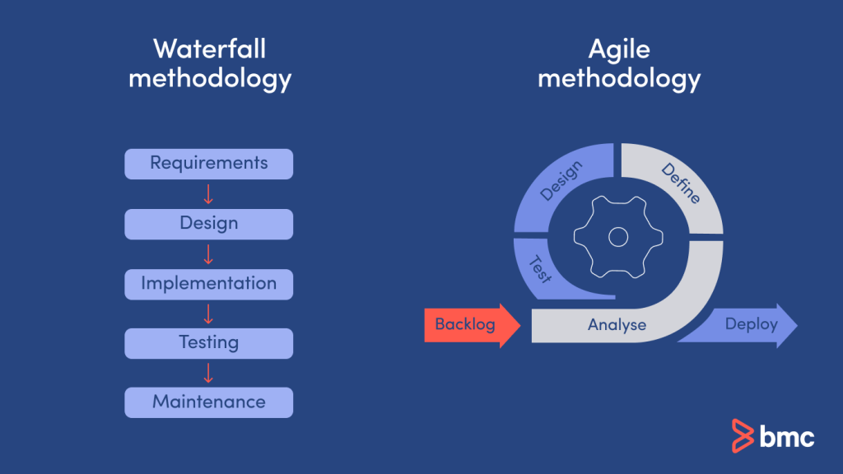
Waterfall vs Agile

Slide 22
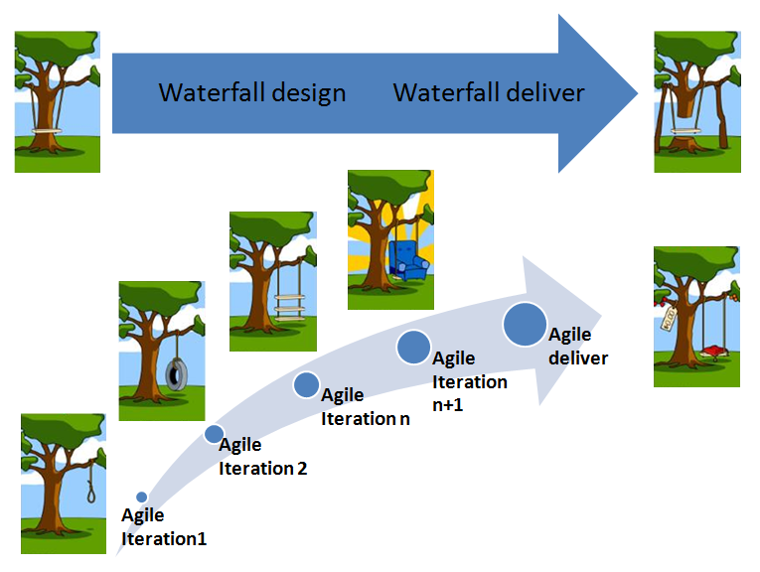
Waterfall vs Agile

Slide 23
THANK YOU

